Slide 1
Image Sentiment Analysis with CNN
Zheng Lu

Slide 2
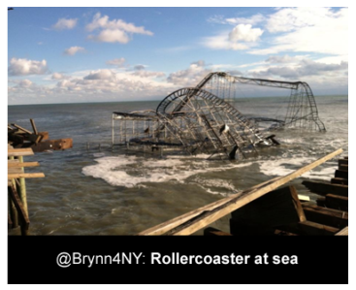
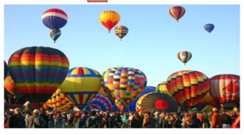
Image Sentiment Analysis
Text Sentiment Analysis Computational study of opinions, sentiments, evaluations, attitudes, appraisal, affects, views, emotions, subjectivity, etc., expressed in text.
Help us understand reviews, blogs, comments…
Image sentiment analysis
Notes:
So far, the computational analysis of sentiment mostly concentrates on the textual content.
Extract from product reviews on how people feel about different products
However, the latter one is becoming a pervasive media type on the web. A recent study shows that images constitute about 36 percent of all the shared links on Twitter.
Image sentiment analysis is at its very beginning stage. Limited efforts have been conducted to analyze sentiments from visual content such as images.
Sentiment analysis for images usually use a simpler definition which is the polarity of an opinion which either can be positive, neutral or negative
There exists an affective gap between low-level features and the emotional content of an image reflecting a particular sentiment

Slide 3

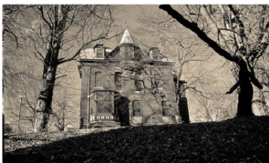
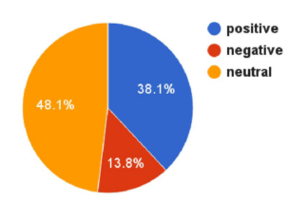
Challenges
There is an gap between low-level features and the emotional content of an image reflecting a particular sentiment [Machajdik ‘11]
Datasets are much harder to collect and may be biased.
Images used for training and testing are those with strong sentiment.
More positive images than negative images.
Figure of sentiment distribution is borrowed from [Unaiza ‘17]
Notes:
There exists an affective gap between low-level features and the emotional content of an image reflecting a particular sentiment
Different people may have different opinion on same image. – overfitting problem
People are more likely to share positive images than negative images. – tend to classify an image to positive

Slide 4
Related work
Adjective Noun Pairs(ANP): “beautiful flower”, “disgusting food” [Borth ’13]
Reflects a strong sentiment
Is frequently used
Has a reasonable detection accuracy
Progressive CNN [You ’15]
Domain-transferred CNN [Chen ’14, Campos ‘17]
Facial emotion [shaikh ‘17]
Notes:
To fill the semantic gap, mid-level representations based on visual concepts have been proposed.
Fill the affective gap and automatically infer the sentiments reflected in an image.
1. Detection accuracy has to be high to be able to be more representative.
2. Progressive training: remove instances that is likely to belong to multiple classes
3. Use pretrained networks from Image classification tasks except last layer.
4. Quite accurate. Limited is obvious, only images with faces.

Slide 5
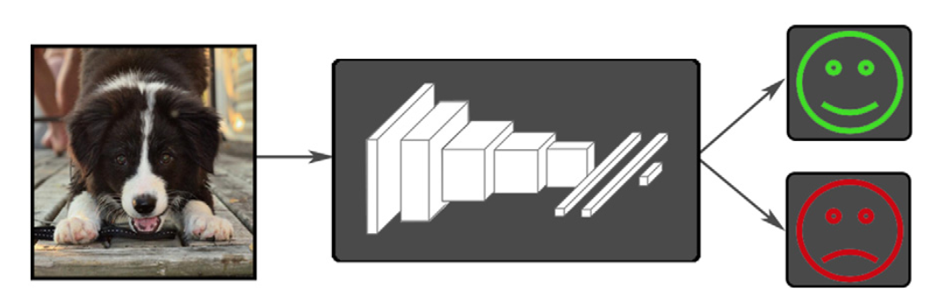
Image Sentiment Analysis with CNN
The last layer contains only two nodes indicate positive or negative sentiment.
The second to last layer output the classification results of ANPs
The challenging part here is that CNNs are really good at identify the “noun” part but not the “adjective” part.
Figure is borrowed from [Campos ‘17]
Notes:
We adopt the ANP mid-level representation in our work.

Slide 6
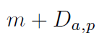

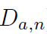
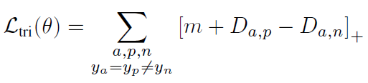
Triplet Loss
Triplet: an anchor image (a), a positive image (p) and a negative image (n)
Triplet loss:
Notes:
M is a margin term, ensure that the distance from anchor image to positive image is much closer to negative image.

Slide 7
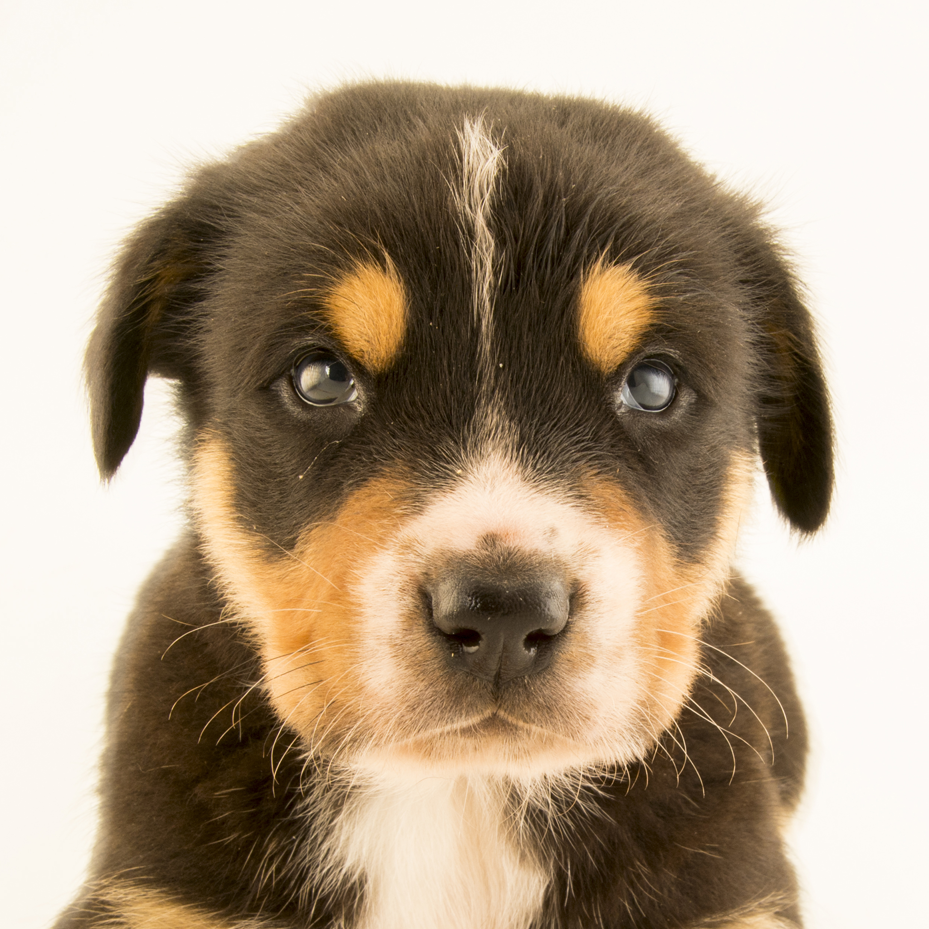
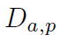


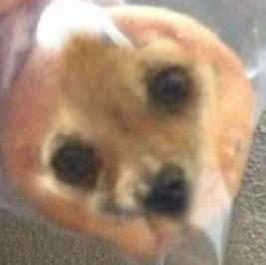
Triplet Loss - challenges
During training, if a, p, n are chosen randomly, the cost function is easily satisfied (the loss is 0). The network won’t learn much.
Choose triplets that’re “hard” to train on. Different positive image, similar negative image.
Notes:
For example, in image classification problem, if your anchor image is a dog.
Positive: a dog from a different view angle.
Negative: a muffin that just looks like a dog.

Slide 8



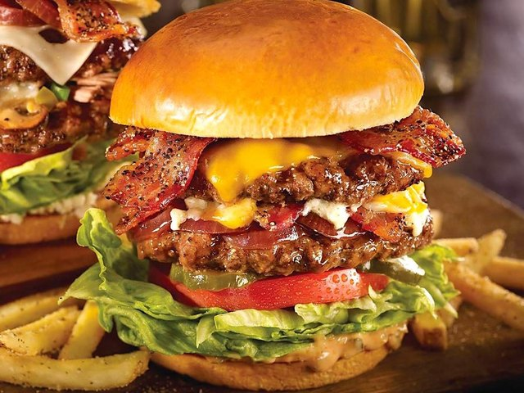
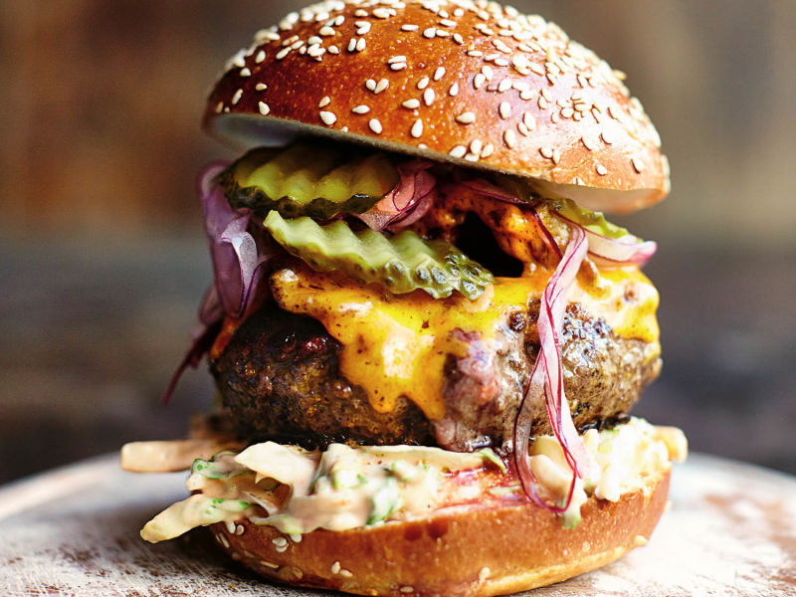
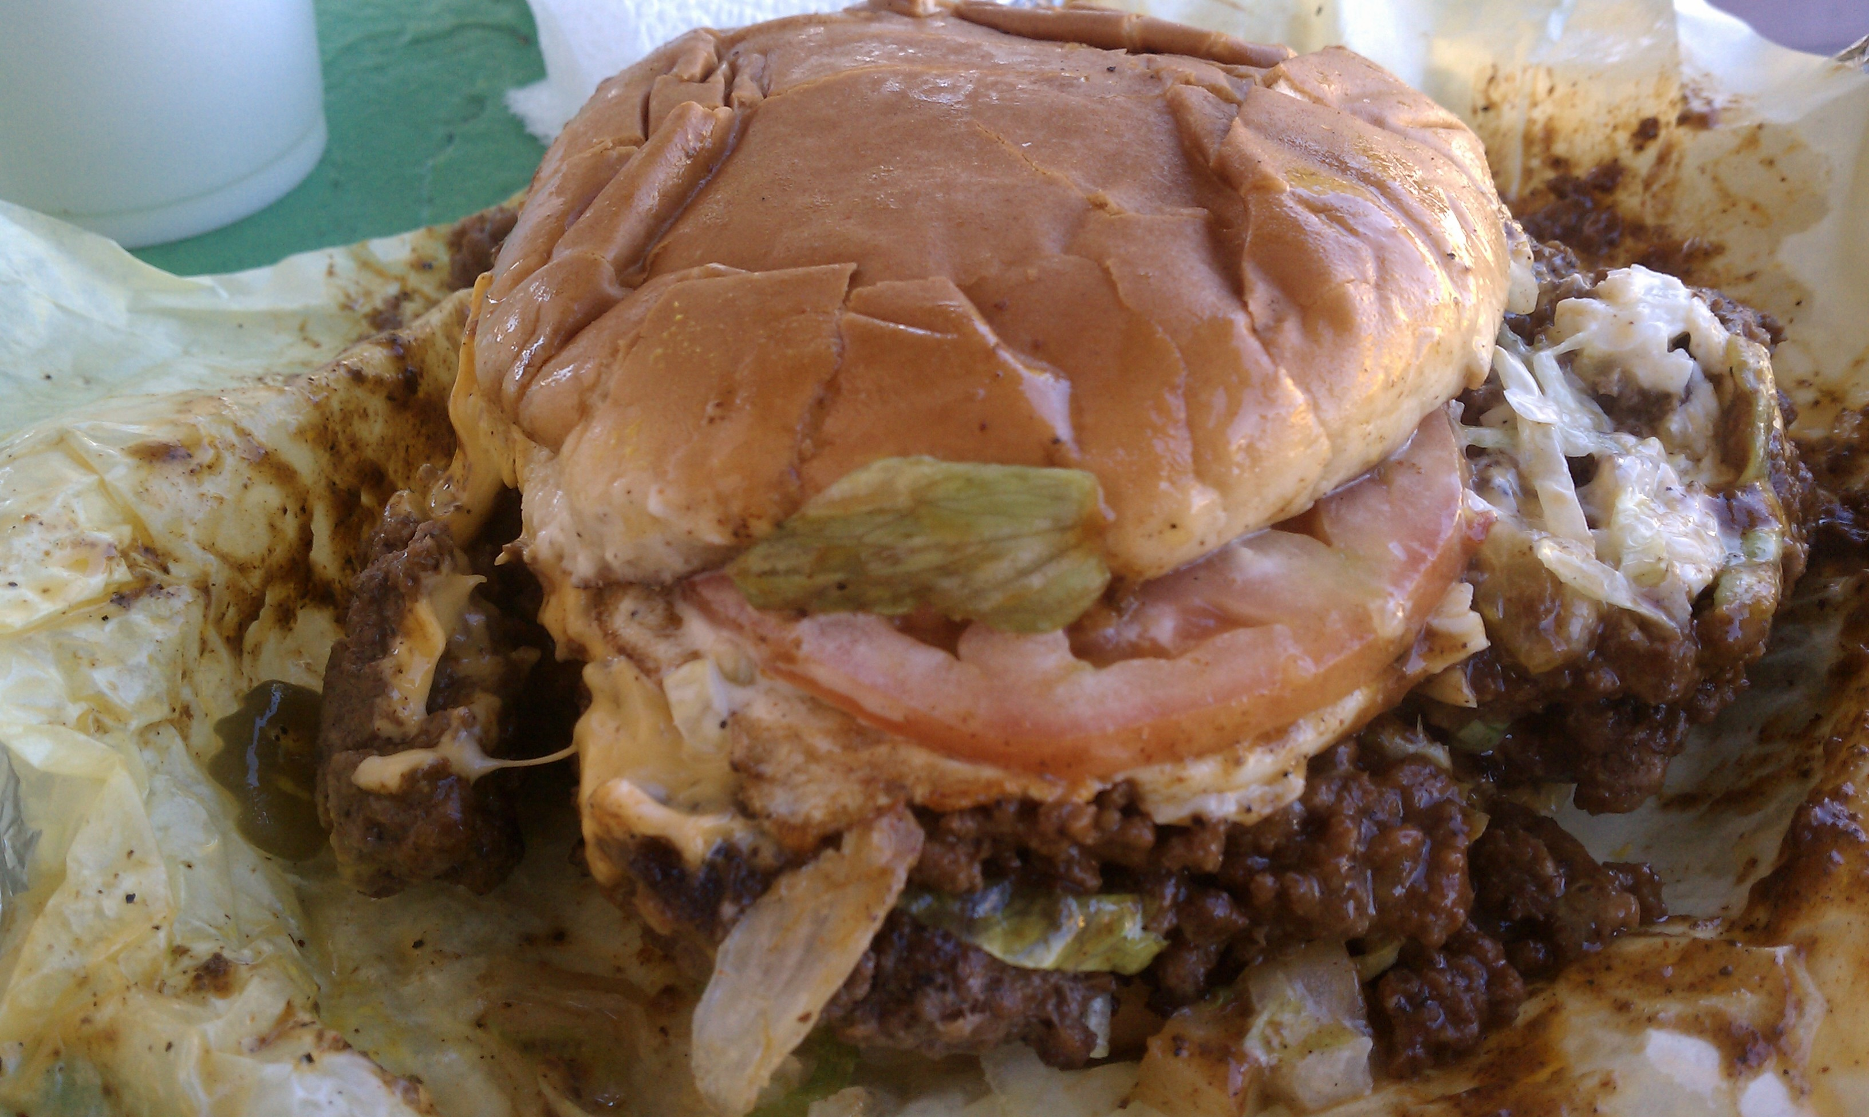
Fix “noun” learn “adjective”
Choose triplets with same “noun”, force the network to learn the “adjective” part.

Slide 9
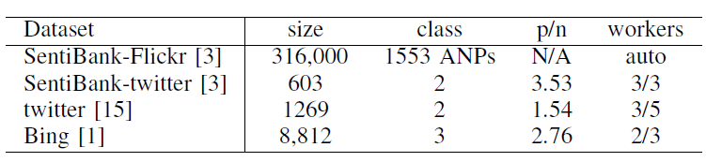
Datasets
SentiBank-Flickr are automatically retrieved by searching Flickr images with each ANP as key word. Our main training set.
The rest are manually labelled. We use them as part as development set and part as testing set.

Slide 10
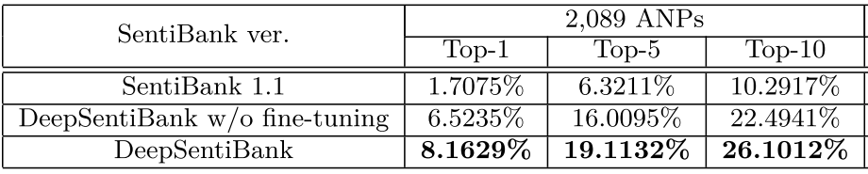
Results of state-of-the-art
The mapping from second to last layer (ANPs) to last layer (Sentiments) are fixed.
Only the classification results of ANPs are reported.

Slide 11
References
[Machajdik ‘11] Affective Image Classification using Features inspired by Psychology and Art Theory.
[Unaiza ‘17] Towards using visual attributes to infer image sentiment of social events.
[Borth ‘13] Large-scale visual sentiment ontology and detectors using adjective noun pairs.
[You ‘15] Robust Image Sentiment Analysis Using Progressively Trained and Domain Transferred Deep Networks.
[Chen ’14] DeepSentiBank: Visual Sentiment Concept Classification with Deep Convolutional Neural Networks.
[Shaikh ‘17] Deep Learning Networks For Visual Sentiment Analysis : CaffeNet and TensorFlow.
[Campos ‘17] From pixels to sentiment: Fine-tuning CNNs for visual sentiment prediction.

Slide 12
Thank you!

